Slide 1
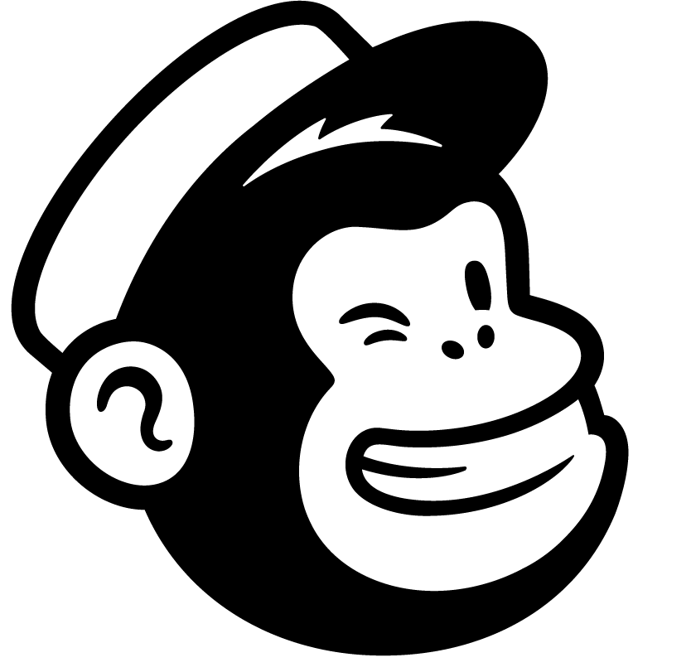
Moishe Lettvin | Principal Engineer, MailChimp
Better Technical Interviews
October 3, 2018
Notes:
Hi, I’m Moishe, I’m a Principal Engineer at MailChimp
I’ve been writing code for money for over 30 years, and I’ve worked at lots of places
Today I want to talk about technical interviews

Slide 2
“The novelist says in words what cannot be said in words.”
Ursula K. Le Guin
Introduction, The Left Hand of Darkness

Slide 3
I regret to inform you
Notes:
One thing I want to say right at the beginning:
I don’t have all the answers
This is a complicated process involving people and is intrinsically profoundly complicated
Knowing a human being is a thing that, let’s face it, best case takes a lifetime
There’s no magic bullet and there’s no one-size-fits-all solution
So we need to embrace ambiguity together.

Slide 4
How I went from an introverted engineer to an introverted engineer who occasionally likes to talk to people:
Notes:
Aka background

Slide 5
Google
Notes:
First real intro to interviewing was at Google
Conducted about 250 interviews
Was on hiring committee for about 6 years
Taught interview training for about 5 years
Learned that I really ENJOYED talking to people in interviews.
Fully bought into Google’s methods, thought they were great, I didn’t question it
I knew they were far from perfect but I also didn’t really think there might be anything better
Little bit of elitism to this.
Passing Google interviews was hard, and random, and getting past them made you a member of a special club
Finally I want to say: I may have a few critiques of how Google interviewed
(not the topic of this talk! But maybe incidental!)
but they are old and I believe Google is committed to improving
Any critiques I have are said with love!

Slide 6
Etsy
🥔
Notes:
Joined Etsy in 2013
Two main takeaways from Etsy: Potatoes, and what it’s like to be a hiring manager
Taught some classes, with Tim Falzone who came up with “potato” metaphor
(explain metaphor)
I was remote so didn’t do a large quantity of interviews,
But I was a hiring manager and interviewing and hiring people for a team that I was managing gave me an *entirely* different perspective
How people can complement a team
Unexpected side effects, amplification of traits
Also learned importance of changing how you *find* candidates if you want to increase diversity

Slide 7
Fast Forward
Notes:
We’re gonna zoom about 2.5 years into the future now

Slide 8
Please indulge me while I talk about my hobby
Notes:
Every weird dad’s dream: a whole room full of people to talk to about my hobby
I love photography. I’ve been doing it off and on since I was about 6 when my mom gave me a Kodak Instamatic
I had a darkroom way back when, etc. etc.

Slide 9
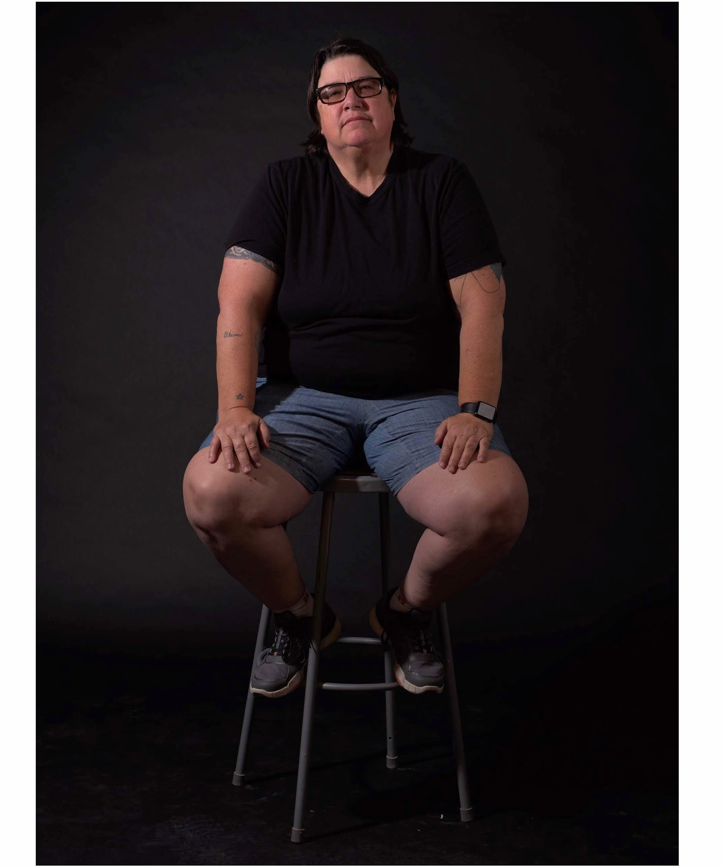
Catherine Opie
Notes:
Just a couple of months ago, I took a class from this woman, who is a personal hero of mine.
She’s a prof at UCLA, and is known for her incredible portraits of her friends in the LGBTQ community, as well as her self-portraits
(I took this portrait of her! It was the highlight of my summer! I don’t even know if it’s good!)
So on the first day of this class, we had to do “portfolio review”. This is where you show some of your best work and invite critique from the teacher and students I should mention I was the least skilled and experienced person in this class, by a lot
Most of the other students were MFAs
Anyway, when it got to be my turn, I showed my portfolio
And said something about “at work, I’m very interested in interviews. I’m super interested in the analogs between how we interview people, and how, in portrait photography, we try to capture something fundamental about an individual, both of these in a constrained and artificial environment, with limited time”
I thought I was being super insightful

Slide 10
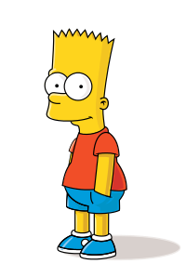
We need to talk about Barthes
Notes:
Now, Cathy Opie is the most down-to-earth, pleasant and kind person you could ever hope to meet.
But she also has a very midwestern straightforwardness, and she doesn’t hesitate to cut right to the chase.
So I said this thing that I thought was so insightful and interesting.
Cathy stepped back from the table (my work was arrayed on the table), and looked me in the eye
She said, “oh, haha, you’re talking about essentialism. That’s not a real thing.”
The rest of my portfolio review was remarkably positive, but I couldn’t stop thinking about what she’d said
I found a paper online called “Essential Non-Essentialism” and tried (I’m a terrible scholar) to wade through it
But: this was the first day of what promised to be a pretty intense week, but I was consumed with this very strong contradiction of a thing I’d just … accepted
I spent weeks thinking about what she said, researching, reading, etc.
It’s not like I’m going to educate myself about postmodern philosophy, essentialism, art history, etc. in a few weeks
But I think I was able to wrap my head around the core of what she meant, which, simply stated is

Slide 11
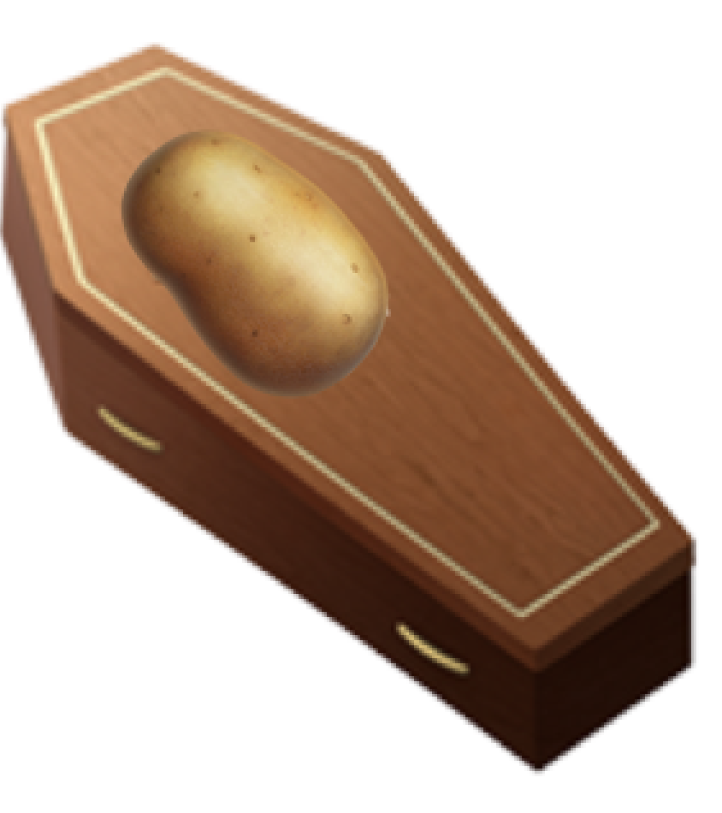
La mort de la patate
Notes:
Earlier I described this idea of “mapping the potato”
The problem is there *is* no potato, not in isolation
I want to go back to photography, specifically portrait photography, to describe what I mean
When you photograph a person, you’re not capturing something essential about them
You’re creating, with them, a representation of the interaction that you had with them
There’s as much you in the photograph as there is them
So let me tell you a story about photography to illustrate this

Slide 12
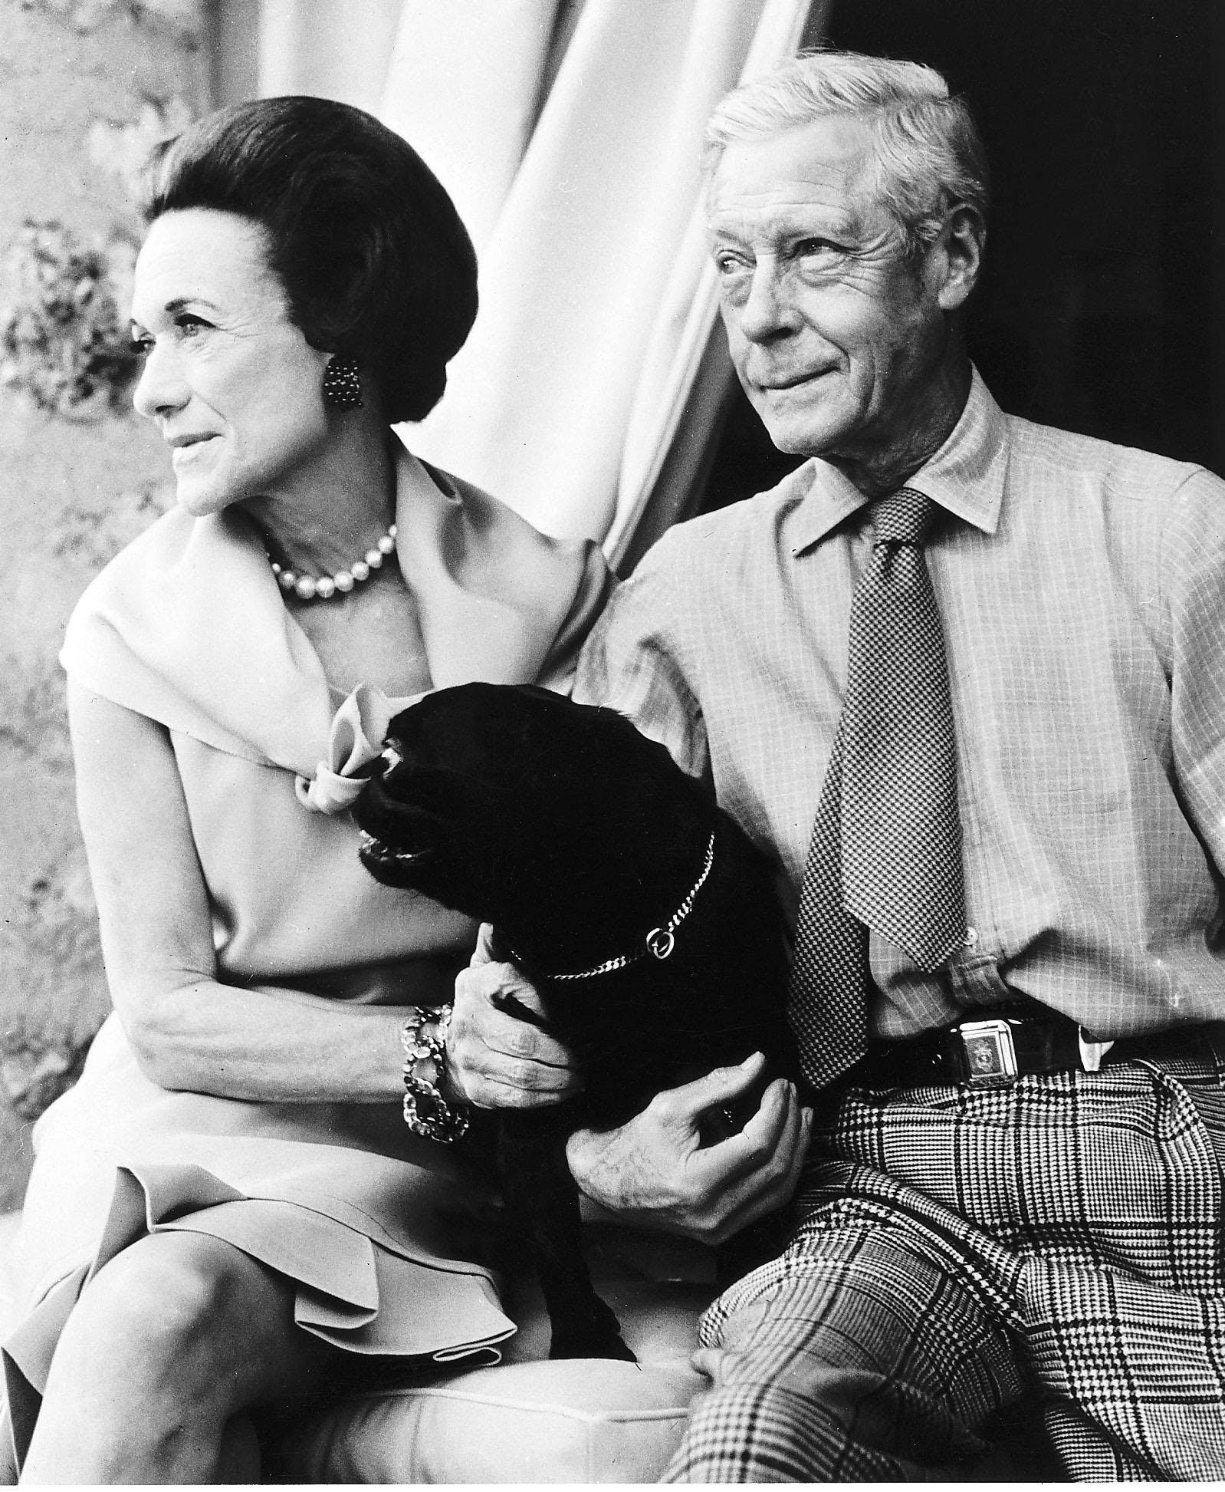
Notes:
This is the duke and duchess of windsor. Briefly the story of these two is that Edward the 8th -- the duke of windsor -- was in line to become King of England, but he abdicated the throne to marry Wallis Simpson, an American woman.
Clearly you don’t give up the throne without some pretty deep feelings about it, but most photographs of this couple frame them as perhaps wistful but *stylish*
And they knew how to be stylish

Slide 13
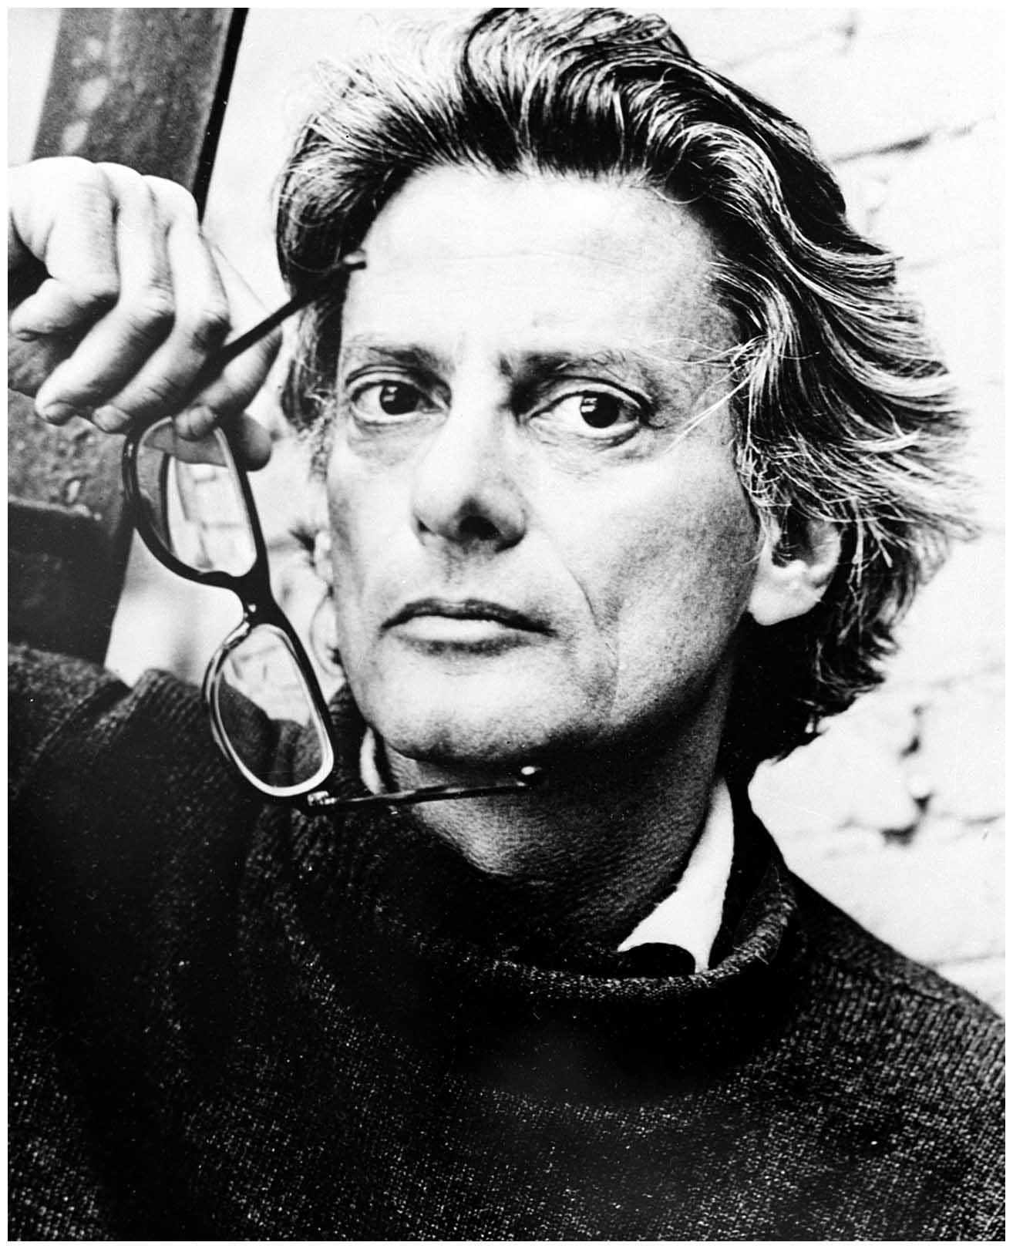
Notes:
This is Richard Avedon, one of the most influential fashion *and* portrait photographers of the 20th century.
Avedon had a split career: he made beautiful fashion photography for Vogue and Harper’s Bazaar, and redefined much of what fashion photography *is*
But he also has an incredible portfolio of personal work, nearly all of it portraits, and all of them are *challenging*. Rarely are they pretty, but they *always* feel true.
A thing you should know: Richard Avedon was Jewish
Another thing you should know

Slide 14
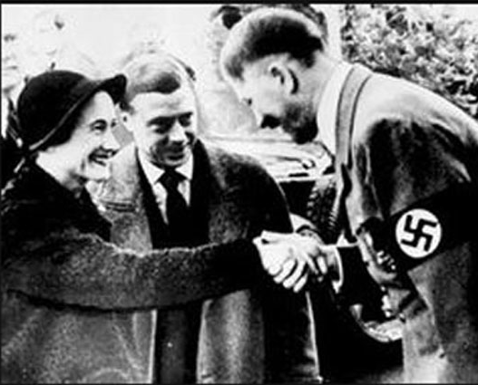
Notes:
…
The Duke and Duchess of Windsor were Nazi sympathizers.
Also, this is important to the rest of the story: they loved dogs. Here’s a quote: “An invitation to dine at the Windsor's palatial Parisian home in the Bois de Boulogne was something society members would kill for. On these sumptuous occasions, the Duke greeted guests flanked by his four pugs on gold Cartier leads. Earlier in the day, as part of preparations for the party, staff primped and clipped the pugs, who were then sprayed with Miss Dior, the Duchess's favorite perfume, and dressed in mink and diamond-studded collars.”
Avedon photographed the Duke and Duchess of Windsor for (find out who?)
He did not LIKE them
His goal might have been to capture something essential about them, but that thing was filtered through who Avedon was and how that influenced (quite rightly) how he saw this couple.
He arrived 15 minutes late. Being late for an appointment with royalty is probably not something many people can get away with. Avedon could.

Slide 15
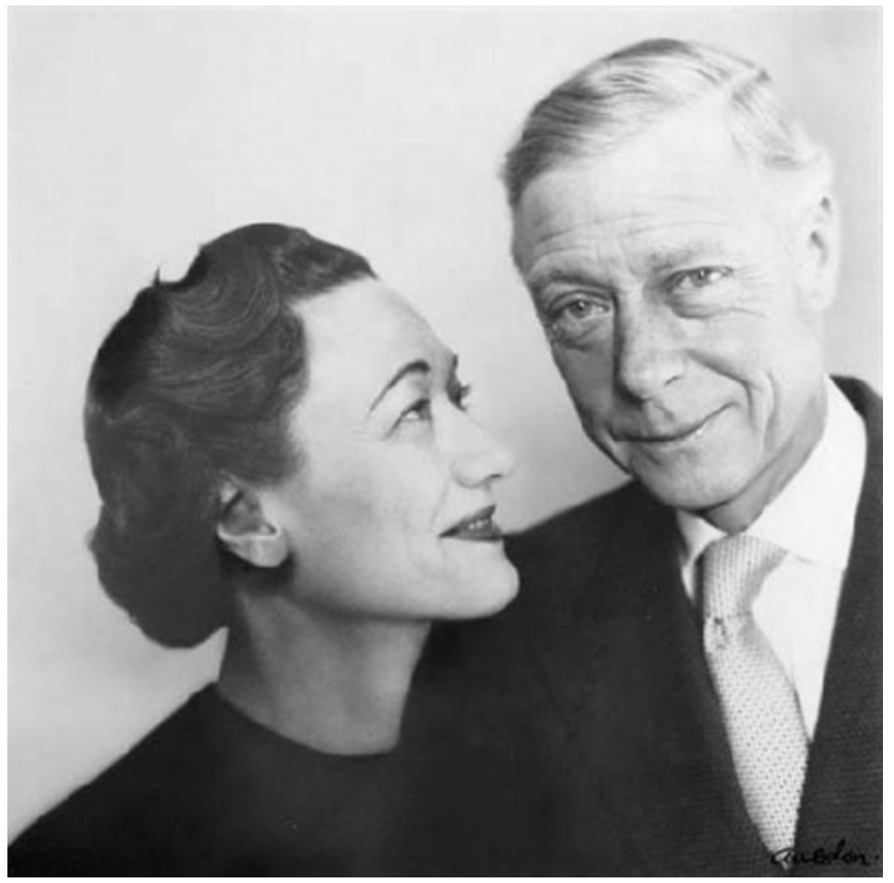
Notes:
He started photographing them, and -- being royalty, and being used to being photographed -- they were being their usual stylish selves. If you look the earlier photos from the shoot, like this one, you can see this quite clearly.
This wasn’t what Avedon *wanted*. He knew what he wanted.
So, he wound his rolleiflex to the next frame, and with the shutter release in his hand, he told the duke and duchess that, by the way, he was very sorry he was late, but on the way to his studio, his taxi ran over a dog and killed it.
As this registered on their faces, he clicked the shutter.

Slide 16
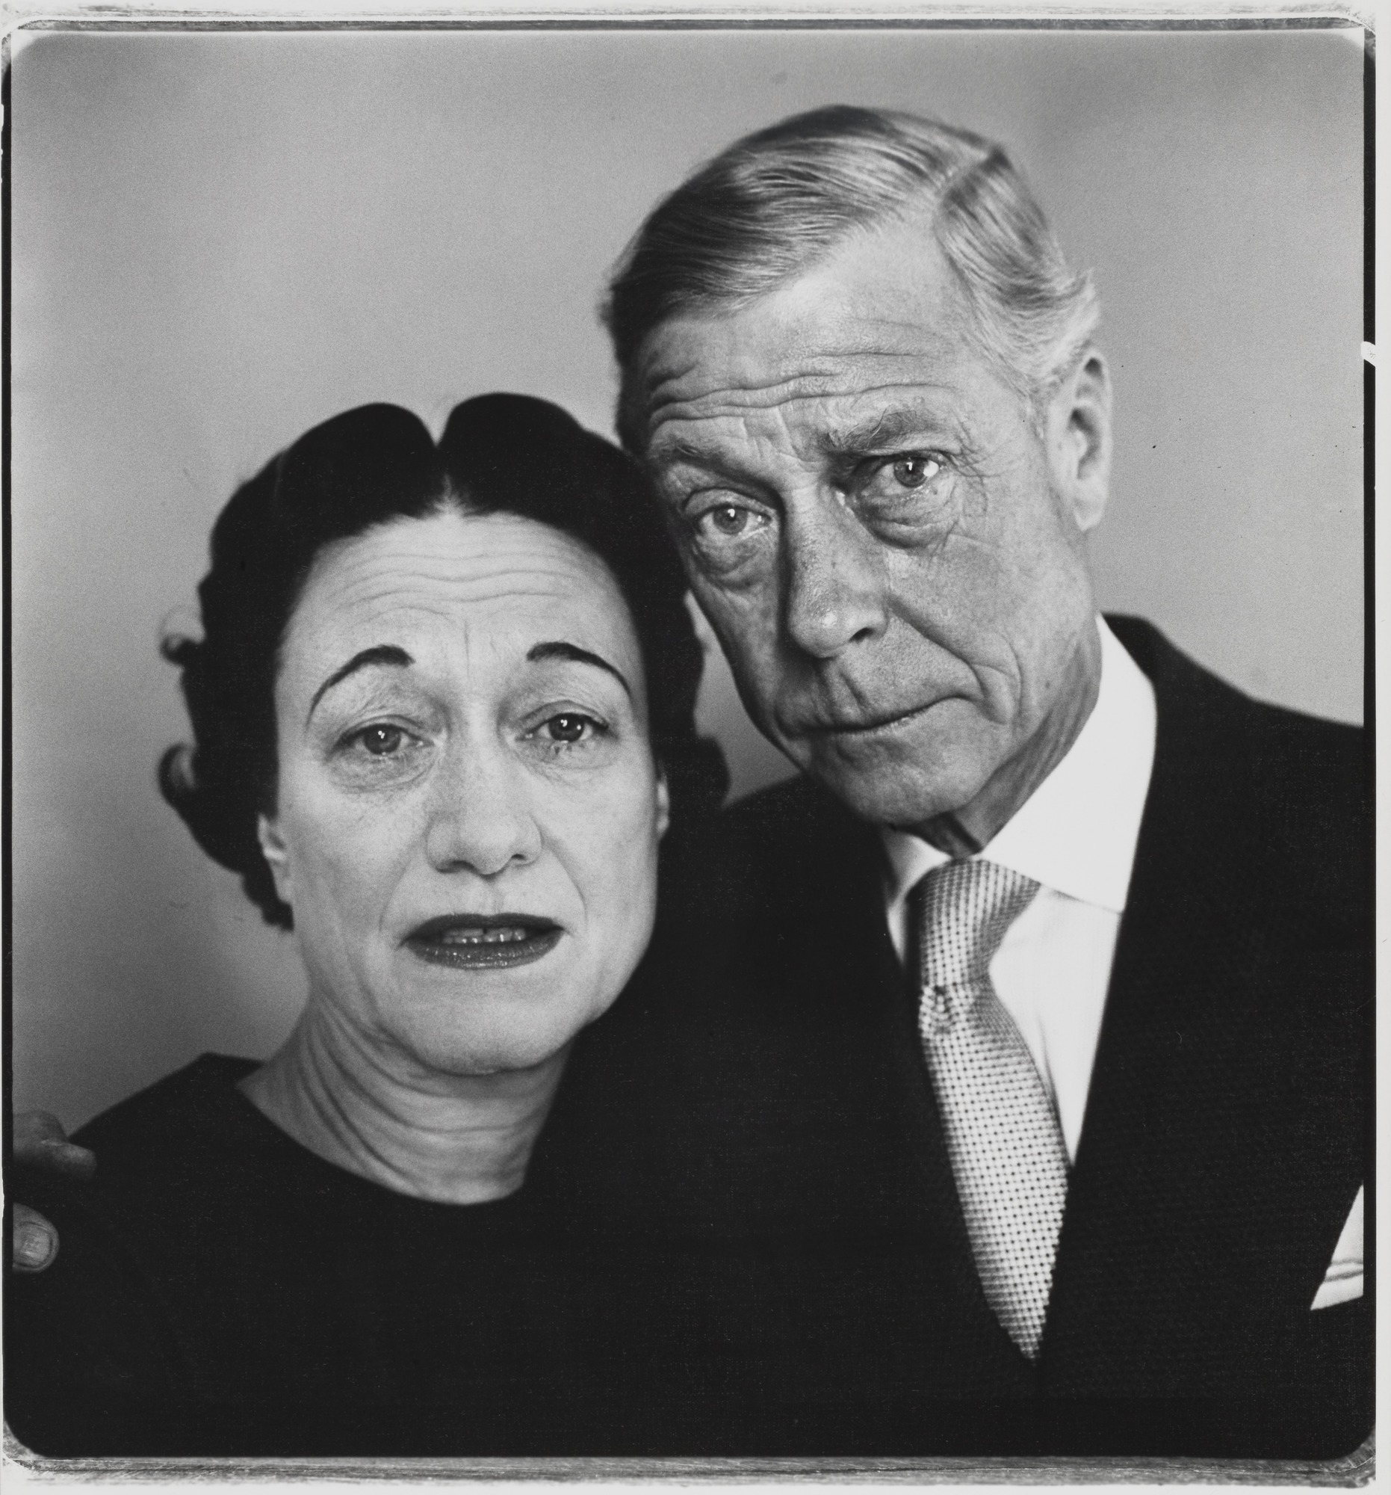
Notes:
This is the picture he captured.
This story’s an outlier. Most of Avedon’s portraits didn’t involve this level of subterfuge. Most portraits don’t (though there are plenty of other examples -- Karsh stealing Churchill’s cigar, etc)
But every portrait involves some kind of manipulation, whether intentional or unintentional. Every. Single. One.
No portrait exists without the indelible imprint of the person who made the portrait. This can be as simple as the conversation you had leading up to the picture, it can be the type of camera you use to make the picture -- an 8x10 view camera puts a subject in a very different frame of mind than, say, an iPhone, it is obviously about when the photographer released the shutter, it is about how the photograph is processed and printed.

Slide 17
Notes:
Which one of these photographs is true? Which is real?
Every one of them says as much about the photographer as it does about the subject

Slide 18
“All photographs are accurate. None of them is the truth.”
Richard Avedon

Slide 19
Okay, nice story
Notes:
So how does this tie into interviewing which is, after all, what we’re here to talk about?

Slide 20
🍠
🥔
🍟
Notes:
In the same way every photograph is as much about the photographer as the subject,
Every interview is as much about the interviewer as it is about the candidate
If a photograph -- which you could argue is the most objective record of a subject you could hope to make -- isn’t and cannot be true, what is?
This sent me into a spiral of confusion -- bad place
It made me think about things which -- I believe -- are foundational and which I never doubted

Slide 21
Morality
Notes:
My belief that we need to act in a moral way wasn’t shaken by this.
We should find candidates who will succeed and who will help us succeed
We should strive to remove biases from our interviews
Our companies should reflect the diversity of the world we live in
We’re in a position to decide, as Anil said, _who is allowed to create_. We should use that power for good!

Slide 22
Kindness
Morality
Notes:
Built on the foundation of morality, we should treat each other with kindness
No interview should make a candidate feel bad, or an interviewer feel bad -- during or as a result of the interview!
But… still. These foundations need to support something to work. They aren’t enough in the abstract
And if we accept the evasive nature of that every evaluation of a candidate also evaluates the interviewer, what can we do?
We need to be kind and moral, but we also need to learn something about a candidate, a process which is subjective and difficult

Slide 23
Wait: isn’t this an ops conference?
Notes:
A few days after my class, I was chatting with my friend Ian about this problem. I felt really stuck, and had sort of fallen into a pit of nihilist despair, if I’m being honest.
<2 months until this talk
Working on interviewing workgroup at work
What does it all mean…???
Ian had a brilliant insight that there’s an analog to how we make our own code work when things can break
We run our buggy code on brittle machines but build resilient *systems*
Can we learn a lesson from that?

Slide 24
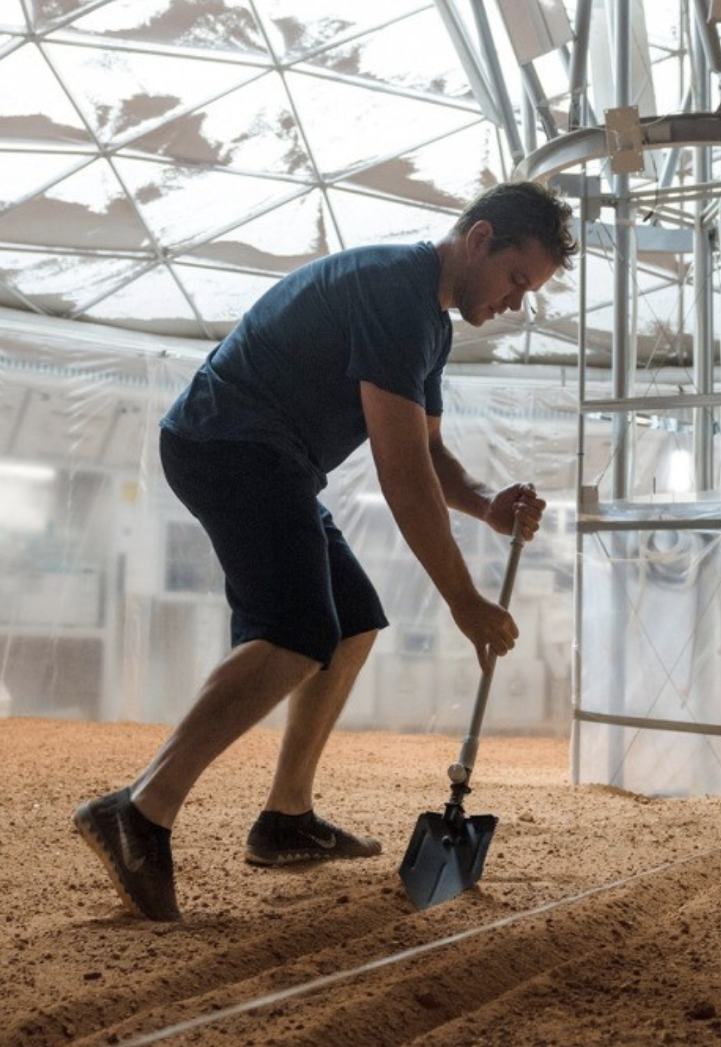
We’re gonna have to DevOps the sh*t out of this!
Notes:
More potatoes

Slide 25
Iteration
Kindness
Morality
Notes:
Iteration
Process level -
Build a process that embraces change!
Don’t be afraid to experiment in smaller settings
Think about the work you make for others by iterating
Eg. “choose your own adventure” at MailChimp: trying it out in Oakland office first
Build individual iteration into the process
If you’re going to interview, do it frequently
Which ties into...

Slide 26
Observability
Iteration
Kindness
Morality
Notes:
Observability
Surveys (candidate and interviewer!)
Are we biasing against underrepresented minorities or women? We can collect data about that.
Mix of anonymized and non-anonymized processes eg. homework v. onsite
Track feedback-about-candidates over time
Google’s histograms are a great example of this
Introspection before and after -- bake it in
Shadows whose job it is to give feedback about the *interview*
Listen to and seek out feedback about the interview
Shadow as much as you can
Train ourselves to make rational decisions, not emotional ones

Slide 27
Redundancy
Observability
Iteration
Kindness
Morality
Notes:
Redundancy
Multiple interviews per candidate, obviously
*Overlapping and redundant* goals
Ideally everyone gets a window into stuff like values
More redundancy for things your org thinks are most important
Staff more and less experienced interviewers to complement each other
Individual questions you ask might answer more than one question
The more important the question you’re trying to answer, the more ways it should be asked
One of the overarching themes of most technical questions is, “what happens when you don’t know”
Maybe a given candidate reacts better to behavioral hypotheticals than technical ones
Low score / high score Google anecdote
Or particular _kinds_ of technical qs. Etcetera

Slide 28
Craft
Notes:
Embrace the *craft* of interviewing
It takes practice
Think about the intentionality of someone like Avedon
Everyone “manipulates” the photograph or interview; the trick is to avoid unintentional noise
Embrace the humanity of interviewing in all its unpredictable glory
On that note

Slide 29
“The interviewer asks in questions what cannot be asked in questions.”
Me
Repeatedly, to anyone who’ll listen
Notes:
Remember that Le Guin quote at the beginning?
This is the thing I think is key at an individual level
You can’t ask “do you enjoy solving problems you don’t know the answer to?”
But maybe you can ask a question the candidate doesn’t know the answer to and see what happens
BUT

Slide 30
“Results of a multiple regression ... showed that narcissism and sadism explained the likelihood of using brainteasers in an interview.”
Scott Highhouse, Christopher D. Nye, Don C. Zhang
Dark Motives and Elective Use of Brainteaser Interview Questions
Journal of Applied Psychology, September 7 2018
Notes:
This is a human endeavor and as such we need to approach it with respect for the individual
So much of this is tailoring an interview to give candidate an opportunity to show their strengths
Making yourself vulnerable is key to letting the candidate be vulnerable
Your goal is to build an environment -- intentionally --

Slide 31
Redundancy
Observability
Iteration
Kindness
Morality
Notes:
Of kindness
The enduring lesson of devops for me has been kindness is foundational
Good devops practices are built on a just culture, which is predicated on the idea that everyone is doing their best.
We get the most information -- in a postmortem, in an interview -- when we can be vulnerable.
It’s a two way street
The great news about this is that part of being kind is being vulnerable.
Being vulnerable leads to empathy and trust in an interview.
And the best interviews happen when there’s mutual empathy and trust

Slide 32
Redundancy
Observability
Iteration
Kindness
Morality
Notes:
(add “morality” to redundancy/observability/iteration ⇔ kindness pyramid)
You must have a moral compass
This is the true lesson, in my opinion, of Avedon’s portraits.
The solution to ambiguity and hard decisions isn’t trying to “program” bias out of the system
The solution, in my opinion, is to be constantly aware of the moral implications of your decisions at every step
If you make nominally “unbiased” hiring decisions, they don’t matter at all if bias manifests in your org in other places
State your values.
Iterate towards your values.
This must transcend interviews and hiring.
This part is profoundly difficult and is the work of a lifetime.

Slide 33
Thank you.

